Slide 1



DHAVAL PATEL
HEMANAND VADIVEL

Slide 2
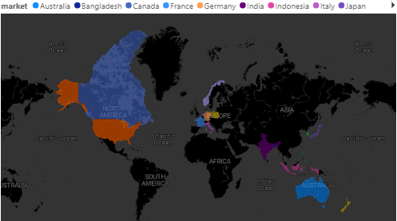
Atliq Hardwares is one of the leading computer hardware producers in India and well expanded in other countries too.
INTRODUCTION

Slide 3





PROBLEMS
However, the management noticed that they do not get enough insights to make quick and smart data-informed decisions. They want to expand their data analytics team by adding several junior data analysts. Tony Sharma, their data analytics director wanted to hire someone who is good at both tech and soft skills
SQL
Extracting valuable insights which will help for effective data driven strategies
Power BI
For data visualisation
Power Point
For presentation
Clipchamp
For video presentation

Slide 4
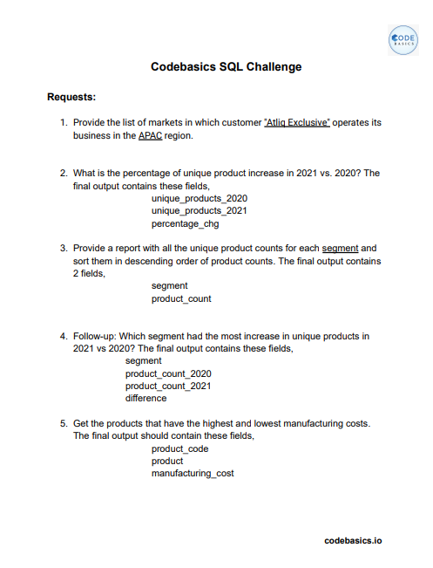
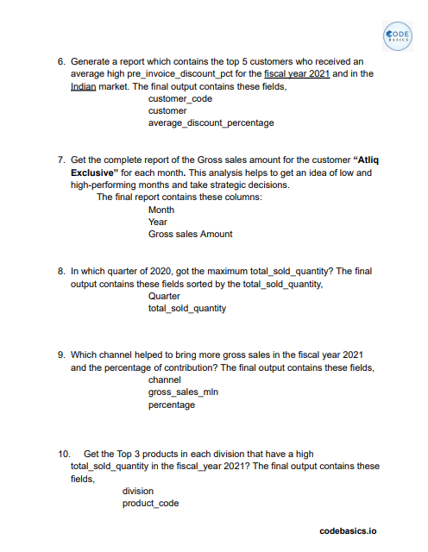

Slide 5
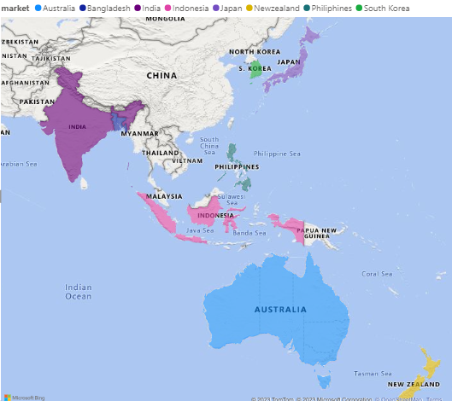
1. Provide The List Of Markets In Which Customer "Atliq Exclusive" Operates Its Business In The Apac Region.
India
Indonesia
Japan
Philippines
South Korea
Australia
New Zealand
Bangladesh
SELECT market
FROM gdb023.dim_customer
where customer = 'Atliq Exclusive’ and region = 'APAC'
;

Slide 6
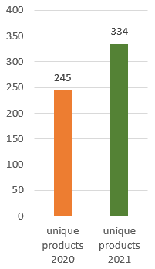
2. What Is The Percentage Of Unique Product Increase In 2021 Vs. 2020? The Final Output Contains These Fields: 2020 Unique Products, 2021 Unique Products, Percentage Change.
2020 Unique Products | 2021 Unique Products | Percentage Change
245 | 334 | 36.33
SELECT unique_products_2020, unique_products_2021,
IFNULL(ROUND(((unique_products_2021 - unique_products_2020) / NULLIF(unique_products_2020, 0)) * 100, 2),0) AS percentage_chg
FROM ( SELECT COUNT(DISTINCT CASE WHEN fiscal_year = 2020 THEN dim_product.product_code END) AS unique_products_2020,
COUNT(DISTINCT CASE WHEN fiscal_year = 2021 THEN dim_product.product_code END) AS unique_products_2021
FROM dim_product
JOIN fact_sales_monthly ON dim_product.product_code = fact_sales_monthly.product_code
WHERE fiscal_year IN (2020, 2021)
) AS subquery;
36.33%
INSIGHTS :
Demand and Production increased which led to introduction of new products

Slide 7
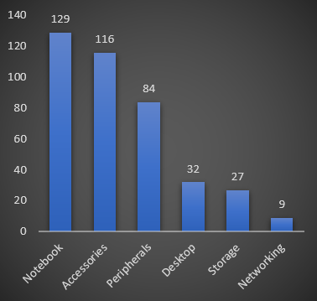
3. Provide A Report With All The Unique Product Counts For Each Segment And Sort Them In Descending Order Of Product Counts. The Final Output Contains 2 Fields: Segment, Product_count.
Segment | Product
Notebook | 129
Accessories | 116
Peripherals | 84
Desktop | 32
Storage | 27
Networking | 9
SELECT distinct(segment) , count(product_code) as product
FROM gdb023.dim_product
group by 1
order by product desc
;

Slide 8
4 ) Follow-up: Which segment had the most increase in unique products in 2021 vs 2020?
The final output contains these fields: segment, Product count 2020, Product count 2021, difference.
Segment | Product Count 2020 | Product Count 2021 | Difference
Accessories | 69 | 103 | 34
Notebook | 92 | 108 | 16
Peripherals | 59 | 75 | 16
Desktop | 7 | 22 | 15
Storage | 12 | 17 | 5
Networking | 6 | 9 | 3
SELECT segment,
COUNT(DISTINCT CASE WHEN fiscal_year = 2020 THEN dim_product.product_code END) AS product_count_2020,
COUNT(DISTINCT CASE WHEN fiscal_year = 2021 THEN dim_product.product_code END) AS product_count_2021,
COUNT(DISTINCT CASE WHEN fiscal_year = 2021 THEN dim_product.product_code END) -
COUNT(DISTINCT CASE WHEN fiscal_year = 2020 THEN dim_product.product_code END) AS difference
FROM dim_product
JOIN fact_sales_monthly ON dim_product.product_code = fact_sales_monthly.product_code
WHERE fiscal_year IN (2020, 2021)
GROUP BY segment
ORDER BY difference DESC
;
INSIGHTS :
We need to find solution for increase in the sale of storage and networking

Slide 9
5. Get the products that have the highest and lowest manufacturing costs.
The final output should contain these fields: product, code, product manufacturing_ cost
Product Code | Product | Manufacturing Cost
A2118150101 | AQ Master wired x1 Ms | 0.8920
A6120110206 | AQ HOME Allin1 Gen 2 | 240.5364
( SELECT fact_manufacturing_cost.product_code, dim_product.product, fact_manufacturing_cost.manufacturing_cost
FROM gdb023.fact_manufacturing_cost
INNER JOIN dim_product ON fact_manufacturing_cost.product_code = dim_product.product_code
ORDER BY fact_manufacturing_cost.manufacturing_cost ASC
LIMIT 1)
UNION( SELECT fact_manufacturing_cost.product_code, dim_product.product,
fact_manufacturing_cost.manufacturing_cost
FROM gdb023.fact_manufacturing_cost
INNER JOIN dim_product ON fact_manufacturing_cost.product_code = dim_product.product_code
ORDER BY fact_manufacturing_cost.manufacturing_cost DESC
LIMIT 1);
;

Slide 10
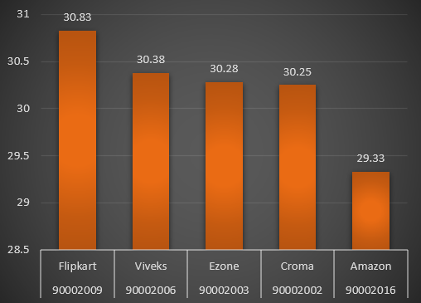
6. Generate a report which contains the top 5 customers who received an average high pre invoice Discount _pct for the fiscal year 2021 and in the Indian market.
The final output contains these fields: customer code, customer, average_discount_percentage
Customer Code | Customer | Average
90002009 | Flipkart | 30.83
90002006 | Viveks | 30.38
90002003 | Ezone | 30.28
90002002 | Croma | 30.25
90002016 | Amazon | 29.33
select dim_customer.customer_code, customer, round(avg(fact_pre_invoice_deductions.pre_invoice_discount_pct)*100,2) AS average
from dim_customer
inner join fact_pre_invoice_deductions
on dim_customer.customer_code=fact_pre_invoice_deductions.customer_code
where fact_pre_invoice_deductions.fiscal_year=2021 and market='India'
group by 1 , 2
order by average desc
limit 5

Slide 11
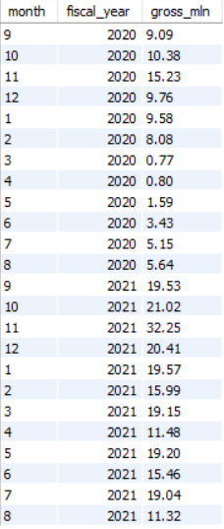
7. Get the complete report of the Gross sales amount for the customer “Atliq Exclusive” for each month.
This analysis helps to get an idea of low and high-performing months and take strategic decisions.
The final report contains these columns: Month, Year, Gross sales Amount
COVID
with cte as
(SELECT month(date) as month , fact_sales_monthly.fiscal_year,
round(sum(fact_gross_price.gross_price*fact_sales_monthly.sold_quantity),0) as gross_price
FROM fact_sales_monthly
inner join dim_customer
on fact_sales_monthly.customer_code=dim_customer.customer_code
inner join fact_gross_price
on fact_sales_monthly.product_code=fact_gross_price.product_code
where dim_customer.customer='Atliq Exclusive'
group by 1,2)
select month , fiscal_year, cast(gross_price/ 1000000 as decimal(10,2)) as gross_mln
from cte
;
12 MLN
BITCOIN MINING , RECOVERCY FROM COVID,
WORK FROM HOME

Slide 12
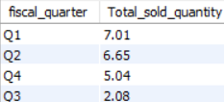
8. In which quarter of 2020, got the maximum total_sold_quantity?
The final output contains these fields sorted by the total_sold_quantity, Quarter total_sold_quantity
with cte as
(SELECT fiscal_year,
sold_quantity ,
CASE WHEN EXTRACT(MONTH FROM date) IN (9, 10, 11) THEN 'Q1'
WHEN EXTRACT(MONTH FROM date) IN (12, 1, 2) THEN 'Q2'
WHEN EXTRACT(MONTH FROM date) IN (3, 4, 5) THEN 'Q3'
WHEN EXTRACT(MONTH FROM date) IN (6, 7, 8) THEN 'Q4'
END AS fiscal_quarter
FROM fact_sales_monthly
where fiscal_year = 2020 )
select fiscal_quarter , round(sum(sold_quantity)/1000000 ,2)as Total_sold_quantity
from cte
group by 1
;

Slide 13
9. Which channel helped to bring more gross sales in the fiscal year 2021 and the percentage of contribution?
The final output contains these fields, channel gross_sales_mln percentage
with cte as (SELECT
dim_customer.channel ,
round(sum(fact_sales_monthly.sold_quantity*fact_gross_price.gross_price)/10000000,2) as gross_sales_mln
FROM dim_customer
inner join fact_sales_monthly
on dim_customer.customer_code=fact_sales_monthly.customer_code
inner join fact_gross_price
on fact_gross_price.product_code=fact_sales_monthly.product_code
group by 1)
select channel, gross_sales_mln ,
ROUND((gross_sales_mln / SUM(gross_sales_mln) OVER ()) * 100, 2) AS sales_percentage
from cte
;
Channel | Gross_sales_mln | Sales_ percentage
Retailer | 269.06 | 72.49
Direct | 60.17 | 16.21
Distributor | 41.94 | 11.30

Slide 14
10. Get the Top 3 products in each division that have a high
total_sold_quantity in the fiscal_year 2021?
The final output contains these fields: division, product_code, product, total_sold_quantity rank, order
with cte as (SELECT division ,dim_product.product_code , product, sum(sold_quantity) as total_sold
FROM dim_product
inner join fact_sales_monthly
on dim_product.product_code=fact_sales_monthly.product_code
where fiscal_year = 2021
group by 1 , 2 , 3),
cte1 as (select division, product_code , product , total_sold ,
row_number() over ( partition by division order by total_sold desc ) as top_product
from cte)
select division , product_code ,product , total_sold
from cte1
where top_product < 4
Division | Product_code | Product | Total_sold | Top_product
N & S | A6720160103 | AQ Pen Drive 2 IN 1 | 701373 | 1
N & S | A6818160202 | AQ Pen Drive DRC | 688003 | 2
N & S | A6819160203 | AQ Pen Drive DRC | 676245 | 3
P & A | A2319150302 | AQ Gamers Ms | 428498 | 1
P & A | A2520150501 | AQ Maxima Ms | 419865 | 2
P & A | A2520150504 | AQ Maxima Ms | 419471 | 3
PC | A4218110202 | AQ Digit | 17434 | 1
PC | A4319110306 | AQ Velocity | 17280 | 2
PC | A4218110208 | AQ Digit | 17275 | 3

Slide 15
THANK YOU!

